Slide 1
Python: Intro to Machine Learning
Business Career Hub

Slide 2
Introduction
Why Machine Learning?
Utilize Big Data
Hardware Improvements
Popular/Common examples
Recommendation Systems: Netflix, Amazon, YouTube, etc.
Image Classification: Facial detection, Self-Driving Cars, etc.
Nature Language Processing: Sentiment Analysis, Auto-complete Text, Text Classification, etc.
Intuitions
Mapping relationships between Inputs (features) and Outputs (target) of the data
Allow algorithms to find relationships within the data

Slide 3
Types of Machine Learning
Supervised Learning
Determine the relationship between inputs and outputs by learning from other input-output data (learn with a teacher)
Classification: identification of a “class” or “category” based on the inputs
Regression: Determine the relationship between dependent and independent variable(s) to predict a continuous number (Ex: demand forecasting)
Unsupervised Learning
Find patterns within data without any reference to any pre-existing labels or values (learn without a teacher)
Recommendation systems, customer segmentation

Slide 4
A Few Terms
ML Algorithms
An algorithm is simply a set of procedures that are followed to perform a task
Examples: Linear Regression, Decision Tree, K-means, Random Forest
Training & Test Sets
Training Set
Fed to our model to learn the relationship between the features and the target label
Test Set
Test our model on data is robust and not overfit.
Features
Data ‘characteristics’ that act as inputs to model. That information is used by the model to make prediction. The better features you choose, the better your model will perform
More features does not always equal better model

Slide 5
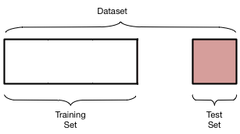

Slide 6
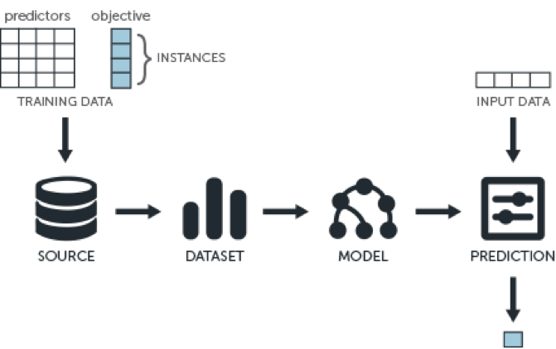
Overview

Slide 7
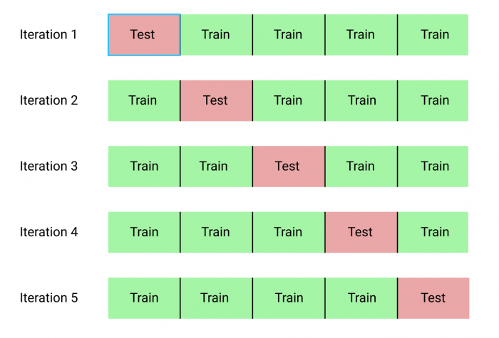
Appendix
K fold validation

Slide 8
Additional Resources
Massive Open Online Courses (MOOC)
Coursera
“Machine Learning” and “Deep Learning” by Andrew Ng of Stanford University
Fast.ai
EDX
CS229 - Stanford U.
Research Papers
Arxiv.org
jmlr.org

